Slide 1


CONSUMER GOODS
AD_HOC INSIGHTS
Created By Ayush Donga

Slide 2

AGENDA
INTRODUCTION
OBJECTIVES
DATA REQUEST AND TOOLS
10 AD-HOC REQUEST

Slide 3
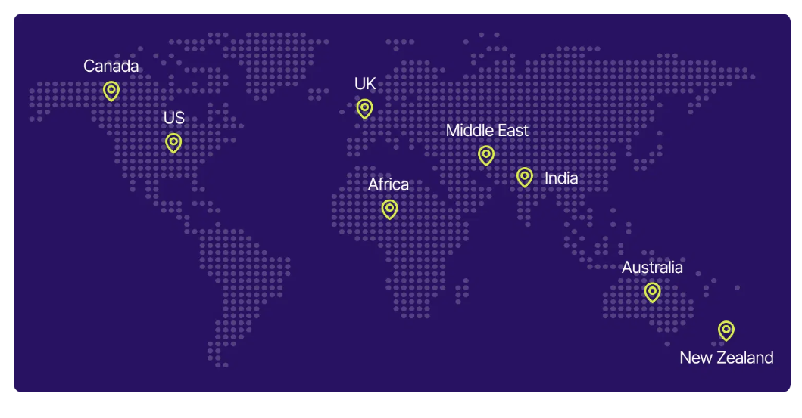
INTRODUCTION
About Company
Atliq Hardware is a prominent computer hardware producer based in India, holding a leading position not only in the Indian market but also in various other International Market. The company operates on a fiscal year calendar running from September to August, where FY 2020 corresponds to September 2019 to August 2020, and FY 2021 spans September 2020 to August 2021.

Slide 4
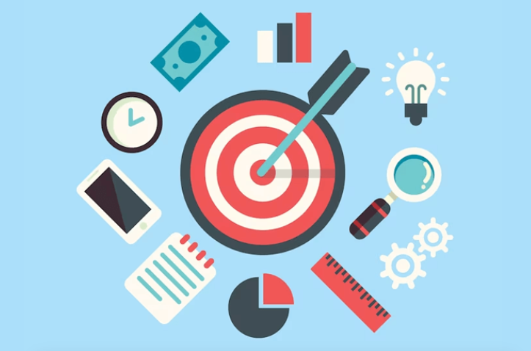
OBJECTIVES
Enhance Decision Making: Company can take quick Decision based on this analysis so our time and efforts are also Save.
Identify Sales Trends: Company can Identify the sales of different years or months with different segments or divisions.
GROSS_SALES: Calculate and check GROSS_SALES of company and take decision on it for improve it.
Examine Applicant Skills: Code Basics give a Resume Project Challenge on this company data so company can check skills or
Proficiency interview Candidate.

Slide 5
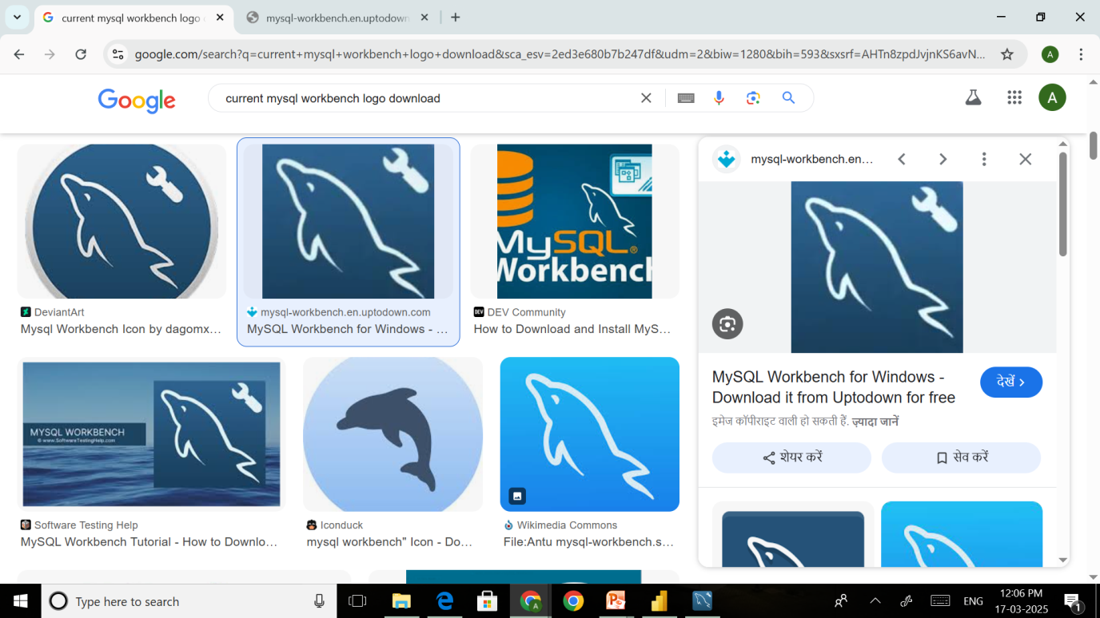

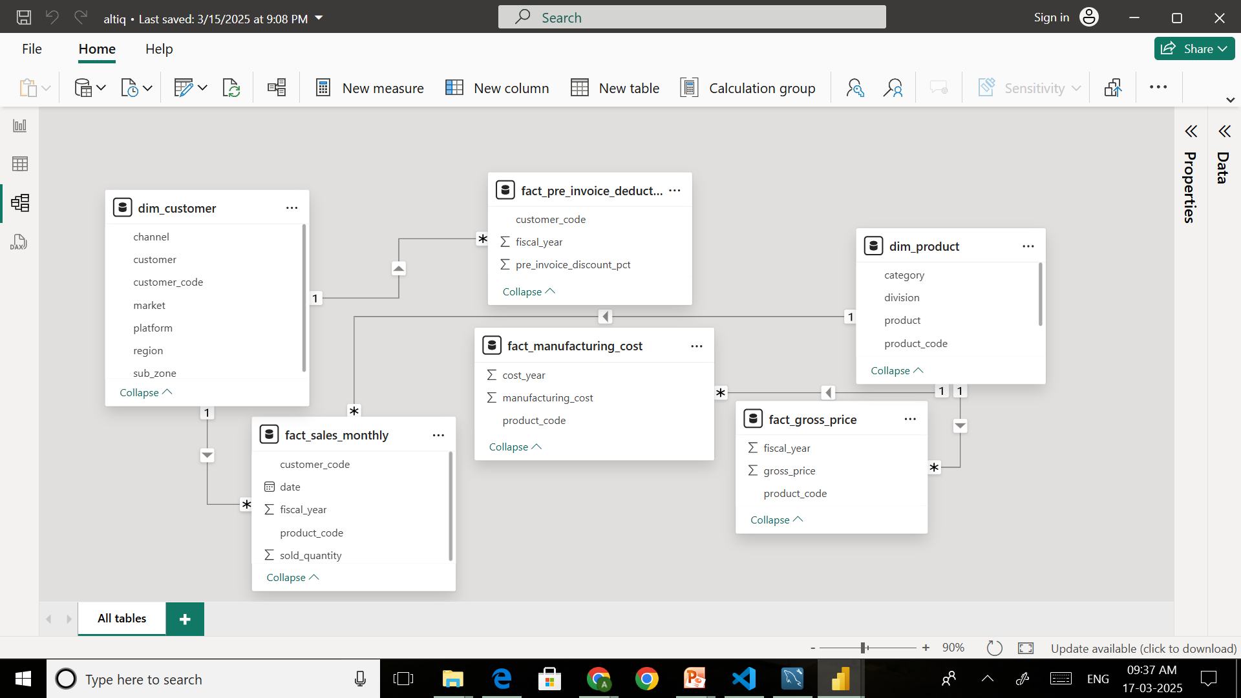
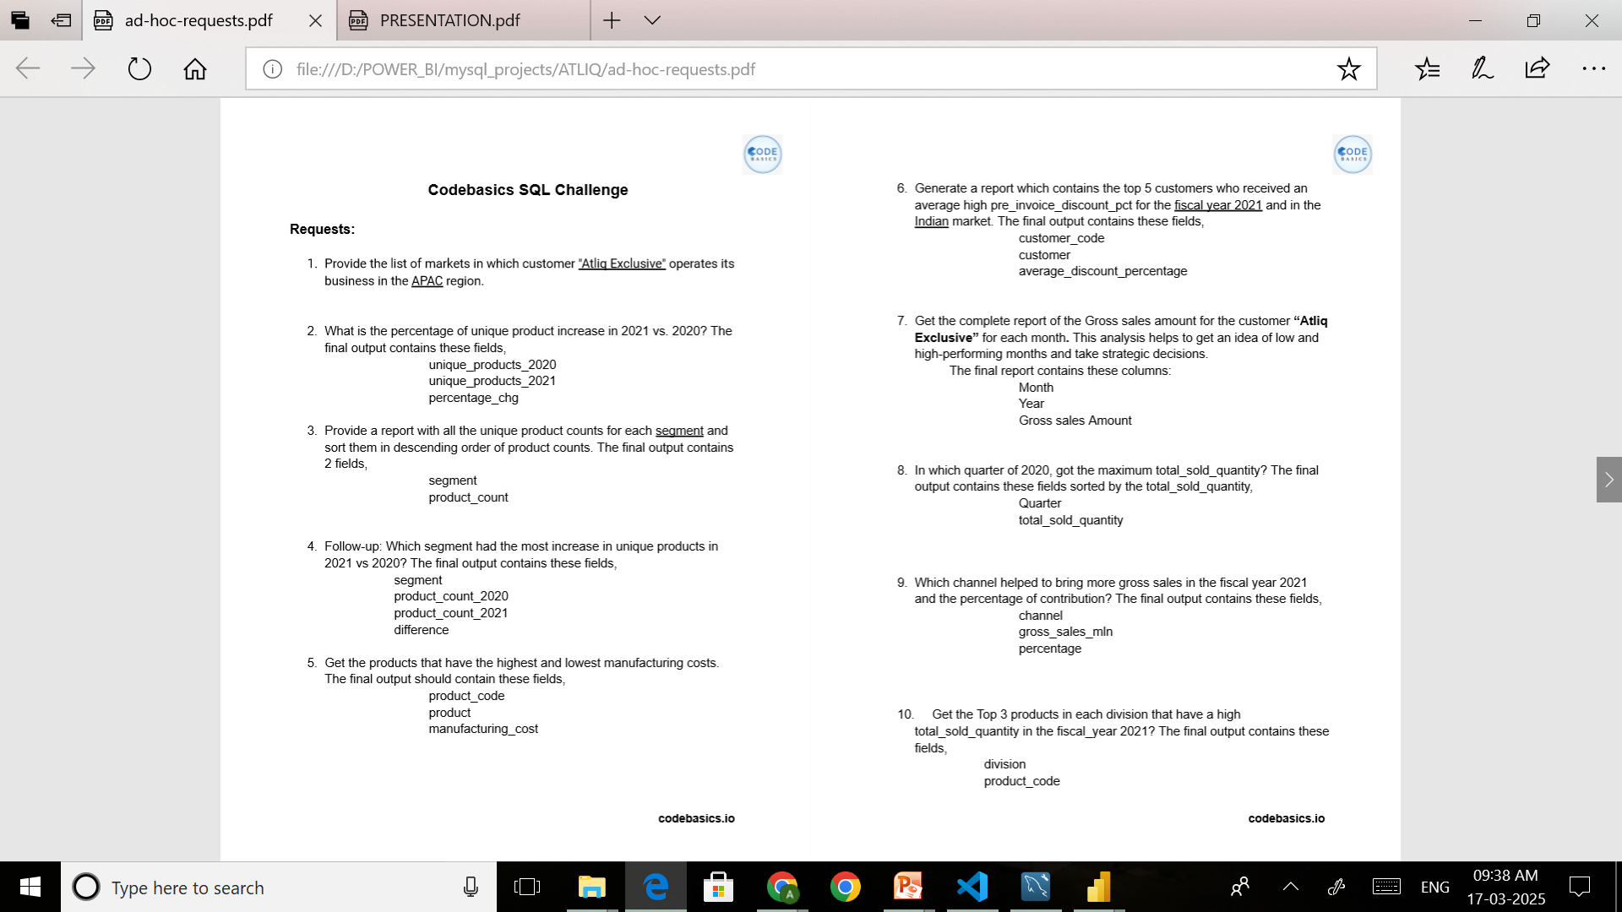
DATA REQUEST AND TOOLS
Tool Used

Slide 6
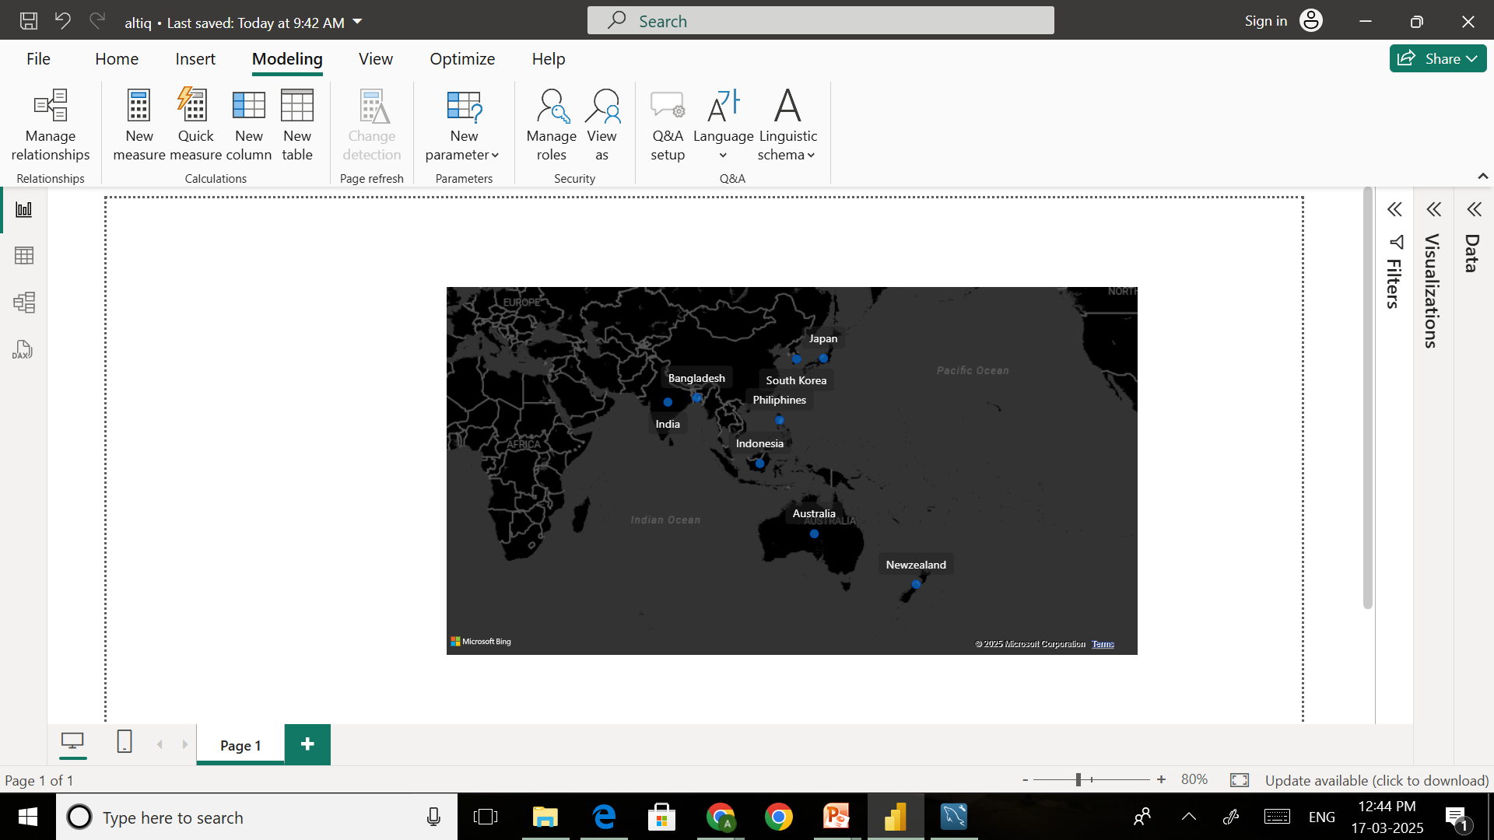
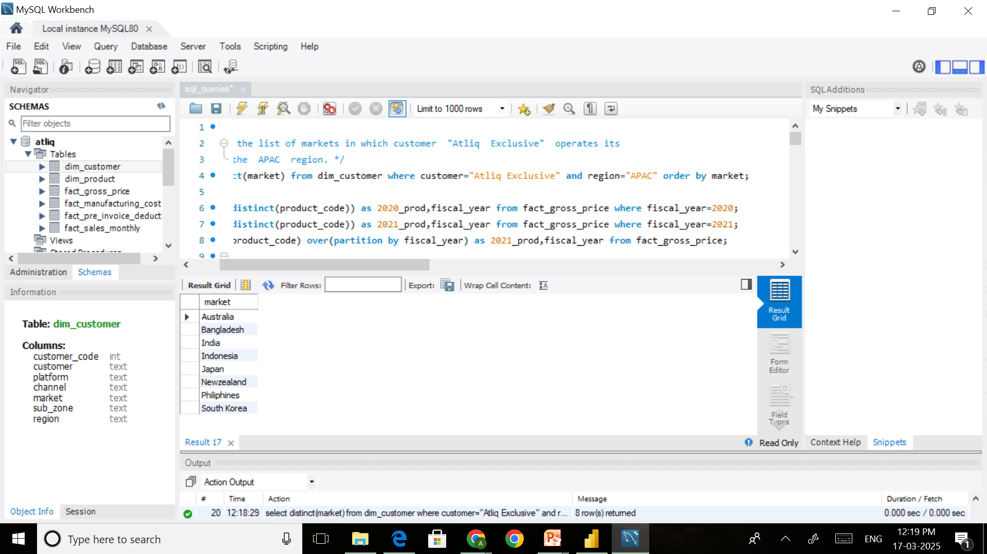
10 AD-HOC REQUEST
Request 1:
Provide the list of markets in which customer "Atliq Exclusive" operates its business in the APAC region.

Slide 7
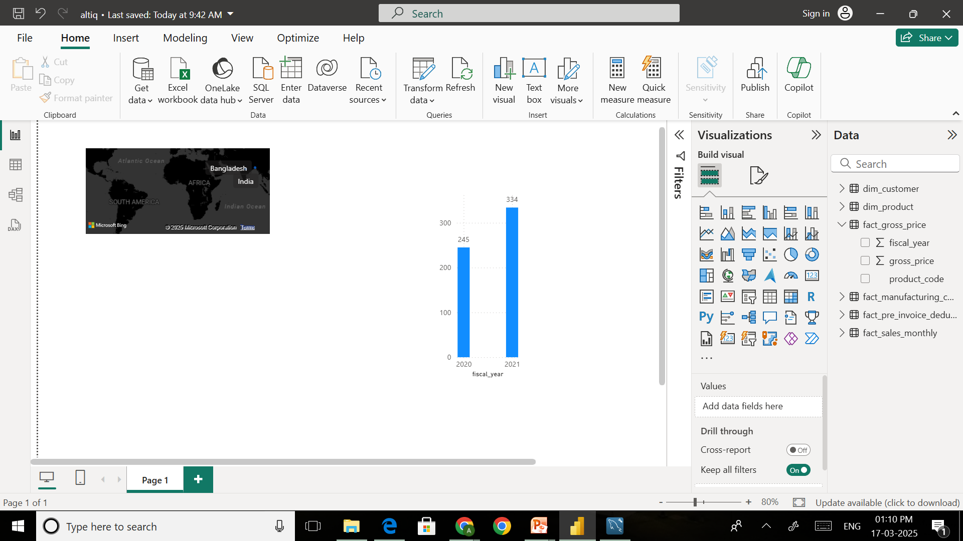
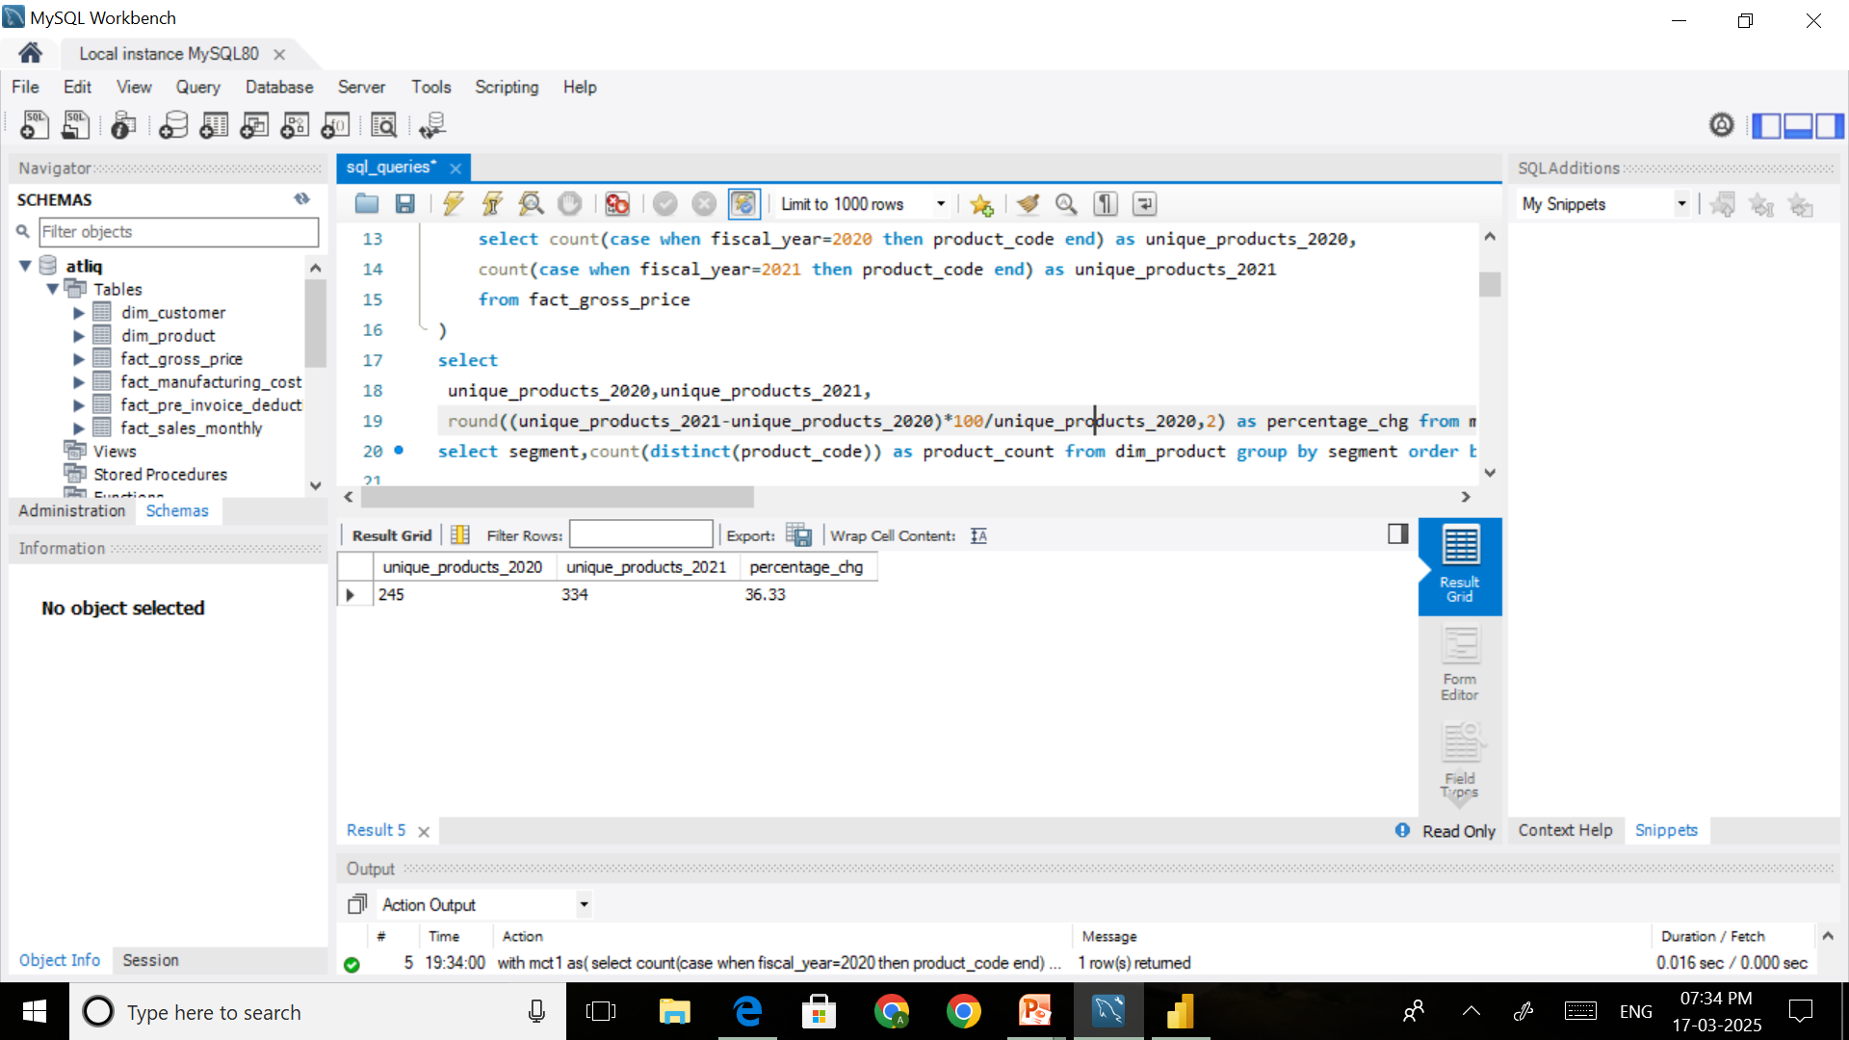
Request 2:
What is the percentage of unique product increase in 2021 vs. 2020?
INSIGHTS: Compare to 2020 in 2021 unique products are increase 234 percentage.

Slide 8
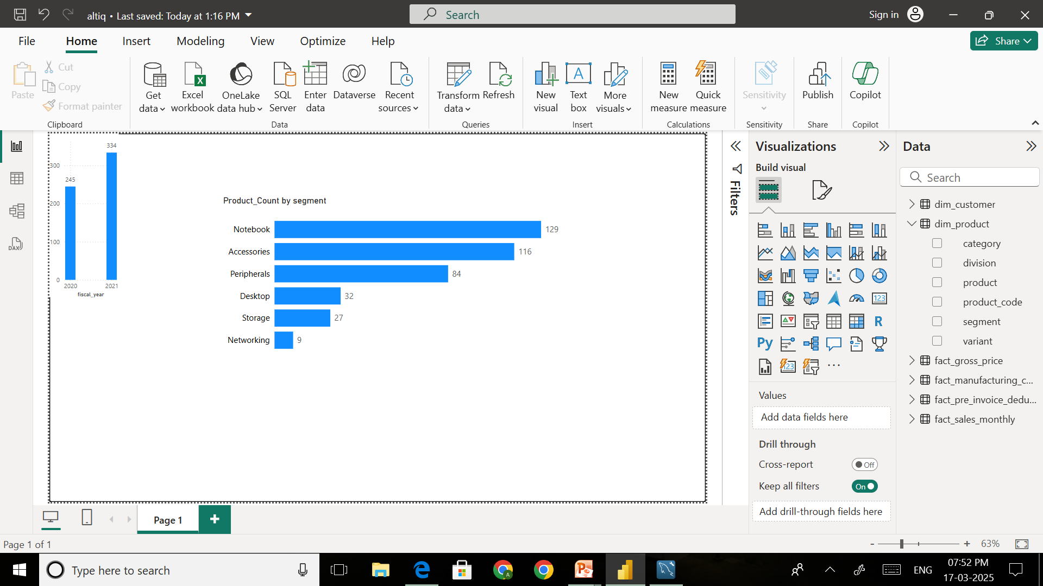
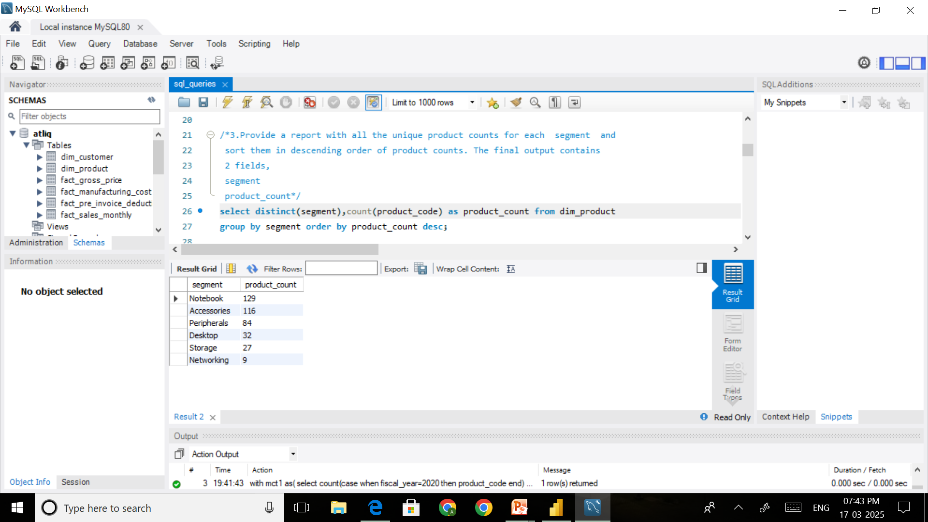
Request 3:
Provide a report with all the unique product counts for each segment and
sort them in descending order of product counts.
INSIGHTS: In Desktop(32) and Storage(27) and Networking(9) Devices segment had less products.

Slide 9
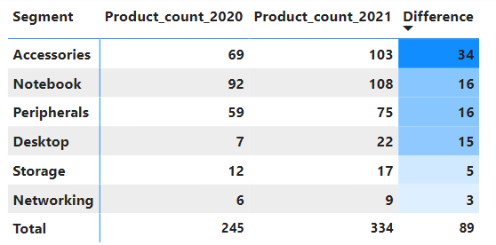
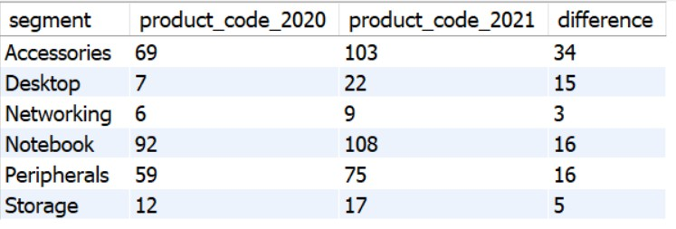
Request 4:
Follow-up: Which segment had the most increase in unique products in 2021 vs 2020?
INSIGHTS: In Storage and Networking and Desktop products Sales is Less increase in 2021 compare to other Products Sales Increment.

Slide 10
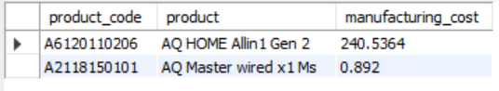
Request 5:
Get the products that have the highest and lowest manufacturing costs.
Personal PC
$240.54
Wired Mouse
$0.89
INSIGHTS: Personal PC has highest manufacturing cost of $240.54 and Wired Mouse has lowest manufacturing cost of $0.89.

Slide 11
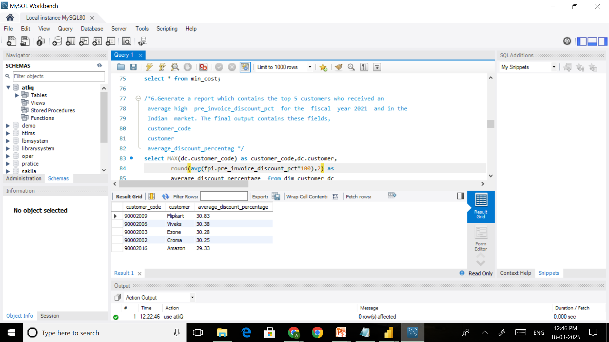
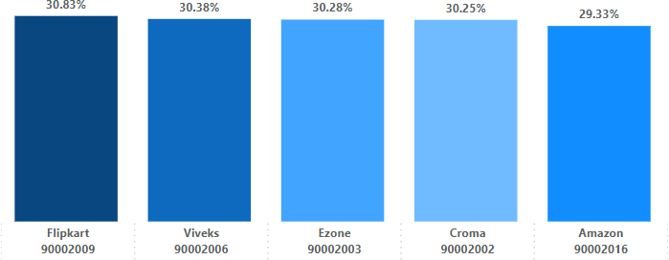
Request 6:
Generate a report which contains the top 5 customers who received an average high pre_invoice_discount_pct for the fiscal year 2021 and in the Indian market.
INSIGHTS: In Fiscal Year 2021 there are 5 customers of Indian market who received an average high pre_invoice_discount_pct they are Flipkart,Viveks,Ezone,Croma,Amazon with around .

Slide 12
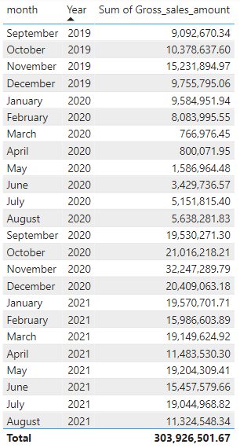
Request 7:
Get the complete report of the Gross sales amount for the customer “Atliq Exclusive” for each month . This analysis helps to get an idea of low and high-performing months and take strategic decisions.
FY 2020
FY 2021

Slide 13
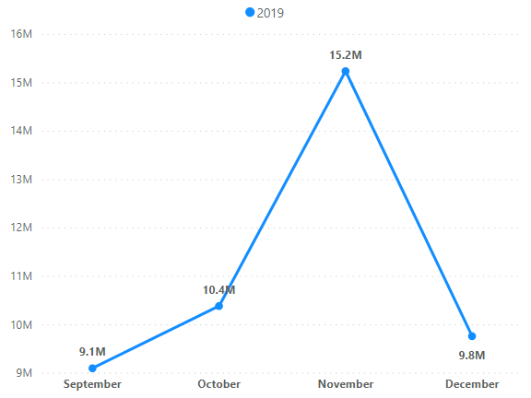
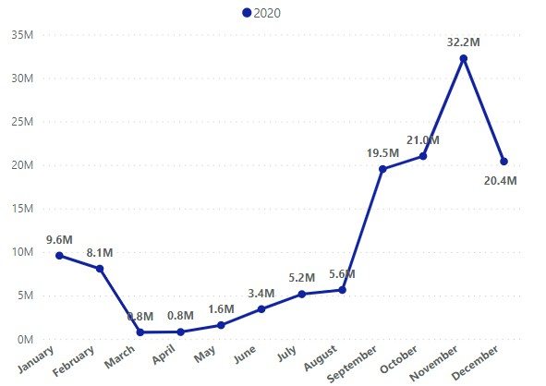
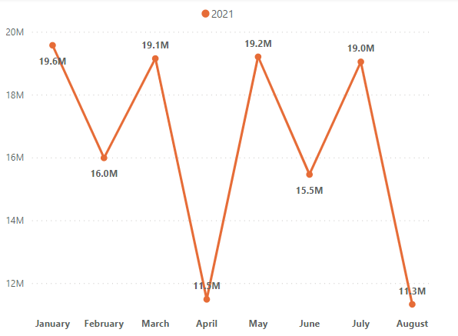
Request 7:
INSIGHTS: In YEAR 2019 highest Gross sales amount is 15.2M in November and In YEAR 2021 highest Gross sales amount is 32.2M in November and In YEAR 2021 highest Gross sales amount is 119.6M in January of customer “Atliq Exclusive”.

Slide 14
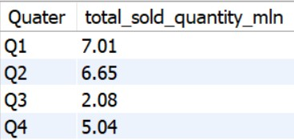
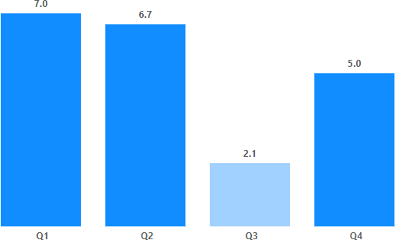
Request 8:
In which quarter of 2020, got the maximum total_sold_quantity? The final output contains these fields sorted by the total_sold_quantity.
INSIGHTS: In YEAR 2020 Quarter 1 had maximum total_sold_quantity which is 7.01M.

Slide 15
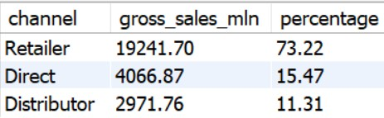
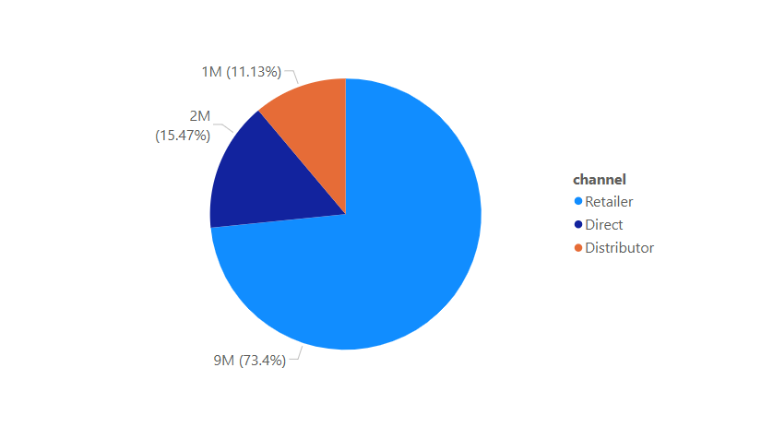
Request 9:
Which channel helped to bring more gross sales in the fiscal year 2021 and the percentage of contribution?
INSIGHTS: Retailer channel helped to bring more gross sales in the fiscal year 2021 of 73.22%.

Slide 16
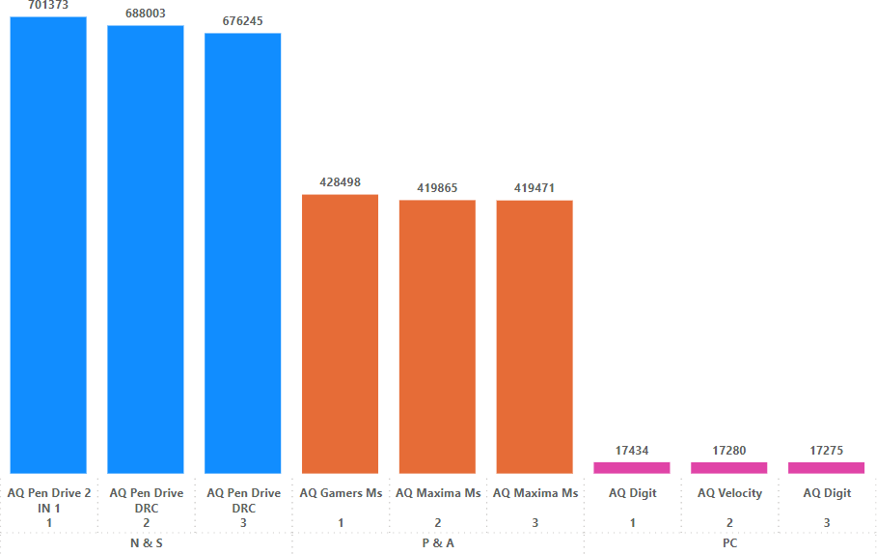
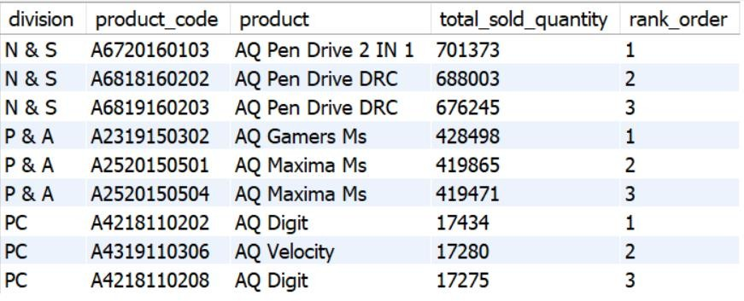
Request 10:
Get the Top 3 products in each division that have a high total_sold_quantity in the fiscal_year 2021?
INSIGHTS: Retailer channel helped to bring more gross sales in the fiscal year 2021 of 73.22%.

Slide 17


